Slide 1

Q2 2023 presentation Nordea – 25 August 2023
Carsten Hellmann, CEO Claus Steensen Sølje, CFO & EVP Per Plotnikof, Head of IR

Slide 2


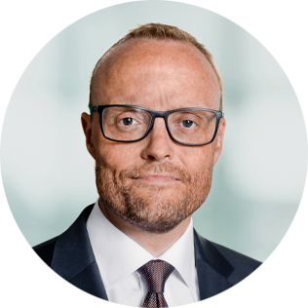
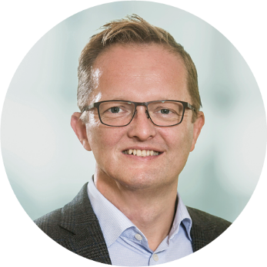
Agenda and presenters
Highlights
Performance
Market trends
Product trends
Financials
Strategy update
Overall progress
Indicators for EU tablet sales
Medium- and long-term tablet drivers
2023 outlook
Q&A session
President & CEO
Carsten Hellmann
EVP, Group CFO
Claus Steensen Sølje
VP, Head of IR
Per Plotnikof
This presentation contains forward-looking statements, including forecasts of future revenue and operating profit, as well as expected business-related events. Such statements are subject to risks and uncertainties, as various factors, some of which are beyond ALK’s control, may cause actual results and performance to differ materially from the forecasts made in this presentation. The coronavirus pandemic, and the extent and duration of countermeasures against the virus, represent additional uncertainties that may also affect forward-looking statements.

Slide 3

Solid Q2 results as expected
FY revenue outlook narrowed; earnings outlook unchanged
11% revenue growth fuelled by tablets and SCIT
Tablet sales up 17%, driven by Int’l markets and North America
Encouraging leading indicators for new tablet patients in Europe
Global tablet opportunity remains strong
SCIT and SLIT-drops sales increased by 13%
Operating profit up 120% on sales growth and margin expansion
EBIT
Revenue
DKKm
+11%
DKKm
+120%
Revenue and EBIT growth rates are stated in local currencies

Slide 4



Growth lead by Int’l markets and North America
European sales impacted by Jext® and trailing effect of lower intake of new tablet patients in past initiation season
Europe
North America
International markets
Share of Q2 revenue
Share of Q2 revenue
Share of Q2 revenue
16%
20%
64%
226m
Q2
Q2
Q2
721m
+2%
232m
+10%
182m
+64%
713m
217m
115m
H1
H1
H1
1,558m
+5%
441m
+9%
370m
+30%
1,504m
403m
293m
2023
2022
857m
2023
2022
2023
2022
Sales in all regions expressed in DKK – Organic growth rates are stated in local currencies

Slide 5





Tablet growth driven by revenue from Torii in Japan
Broad-based, double-digit growth in SCIT/SLIT-tablets continues
Tablets
SCIT/SLIT-drops
Other products
Share of Q2 revenue
Share of Q2 revenue
Share of Q2 revenue
15%
48%
37%
Q2
Q2
Q2
483m
547m
+17%
423m
+13%
165m
-8%
480m
380m
185m
H1
H1
H1
1,128m
+8%
933m
+13%
308m
+1%
1,063m
829m
308m
2023
2022
2023
2022
2023
2022
Sales in all regions expressed in DKK – Organic growth rates are stated in local currencies

Slide 6
Sales growth drives margin improvements in H1
DKK million | H1 2022 | H1 2023
Revenue | 2,200 | 2,369
Gross profit | 1,380 | 1,506
Gross margin | 63% | 64%
Capacity costs | 1,116 | 1,181
EBIT | 264 | 325
EBIT-margin | 12% | 14%
Free cash flow | 93 | (48)
Gross profit
Gross profit
Margin %
DKKm
%
10% growth in local currencies disregarding German rebate increase
One-off costs to leadership changes
Capacity costs
33% growth in local currencies; 23% in DKK
Costs
in % of revenue
DKKm
%
Changes in working capital, investments in production capacity

Slide 7
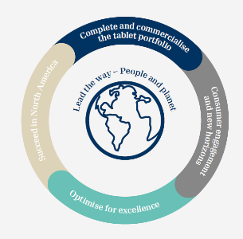









Progress on long-term strategy
Succeed in North America
Complete & commercialise the tablet portfolio
Consumer engagement and new horizons
Optimise for excellence
Execution of new US tablet business model
Independent sales organisation in Canada
Paediatric indications
HDM tablet filed in China
Geographic expansion
Channel expansion
First readouts from peanut trial in 2023
AAI projects in the USA and China
Digital mobilisation and expansion of ‘klarify’ universe
Upscale tablet production
Simplify production set-up and standardise portfolio
Mitigate cost inflation
Growth
Growth & paediatric development
Innovation
Organisational excellence
Mobilise patients
Lead the way
– people and planet
Commitment to science-based targets for Scope 1, 2 and 3 emissions

Slide 8


Promising indicators for H2 tablet sales in Europe
Leading indicators point to stronger initiation season in key European markets
Burdensome pollen flight in H1 2023 across Europe
Substantial burden of disease
Step-up in use of symptomatics (e.g. significant increase in Germany)
Rise in severe symptoms, e.g. +30% on tree allergy by Swedish ‘klarify’ users
More consumers are taking action on their allergy
KPIs for mobilised consumers and online bookings well above target
553,000 (+61%) consumers mobilised in H1; 47,000 confirmed doctor visits
Growing number of new patients initiated in key markets
Key markets are stabilising

Slide 9
Global tablet opportunity remains strong
Solidified by successful Phase 3 trial with HDM tablet in children and Japanese national action plan
North America
EU
China
Japan
Execute new business model, e.g. build new prescriber base and sales channels
Children indication for HDM tablet in 2024/25
Potential children indication for ITULATEK® in Canada
Children indication for ACARIZAX® in 2024/25
Potential children indication for ITULAZAX ®
Improved market access
Unlocking further markets as growth contributors
ACARIZAX® launch in 2024/25
Organisational build-up
Expansion of AIT prescriber base
Government plan to combat growing burden of allergy
Increasing public awareness of AIT
Possible expansion of cedar pollen tablet availability

Slide 10
Full-year revenue outlook has been narrowed
Revenue
8-10% growth in local currencies (previously 7-11%) | 9-11% organic FY growth disregarding one-year, mandatory rebate increase in Germany Jext® sales to decline in H2 Tablet sales still to grow double digits in H2 SCIT/SLIT-drops sales still to grow double digits in H2
EBIT
13-15% margin (unchanged) | Gross margin to improve by up to 1 p.p., amidst modest cost inflation, German rebate R&D costs to decline to ~DKK 600m S&M costs to increase mid-single digit to support growth initiatives Lower capacity cost to revenue ratio still expected
Revenue
DKKm
10% CAGR (l.c.)
EBIT
EBIT margin
DKKm
%
Other assumptions: Current exchange rates. No changes to current product portfolio, incl. acquisitions and/or partnerships. No sizeable payments for M&A/in-licensing.

Slide 11



Q&A session

Slide 12
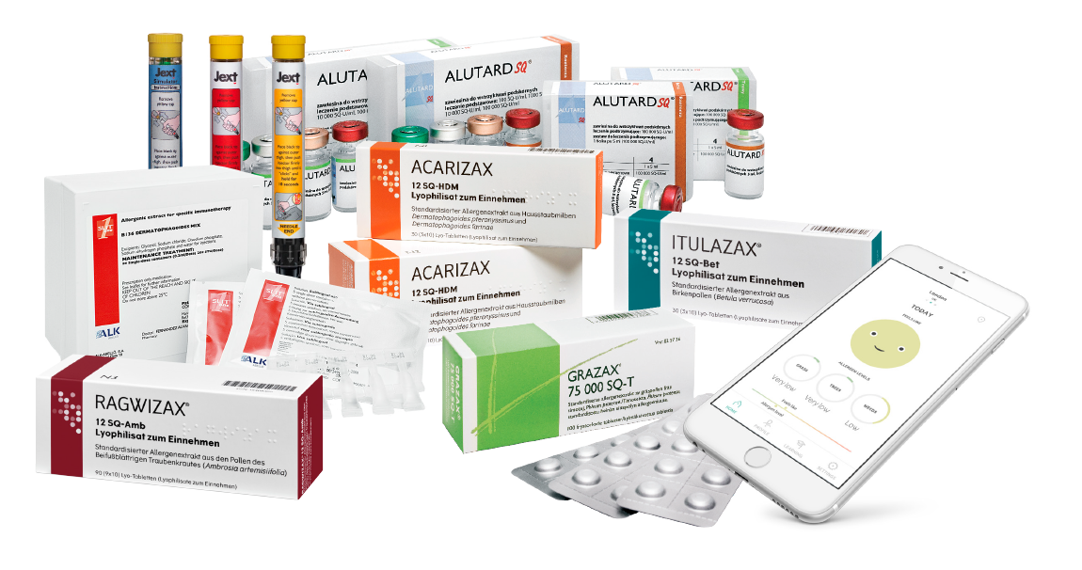
News and events in the second half-year 2023
15 November: Q3 interim report
Q4: Data from Phase 3 trial of ITULAZAX® in children
Q4: Interim readouts from Phase 1 trial in peanut allergy
Investor Relations:
Per Plotnikof, Vice President, Head of Investor Relations
Phone: +45 4574 7576
E-mail: ppidk@alk.net
www.alk.net

